Slide 1

Titanic ML AAT
Gauravesh Sharma 1BM20IS040

Slide 2
Main high lights
Visualize and Fix the dataset
01
Train using Decision Tree and Logistic Regression
02
Compare and evaluating the models
03

Slide 3
DATASET : Titanic Prediction
The dataset includes passenger details and the target variable 'Survived' (0 for not survived, 1 for survived).
The primary data consists of passenger attributes, and the target is predicting survival.
The dataset is skewed due to an imbalance, with more not survived cases than survivors.
The dataset includes Passenger ID, Survived, Pclass, Name, Sex, and Age as key features.
It is divided into train.csv and test.csv

Slide 4
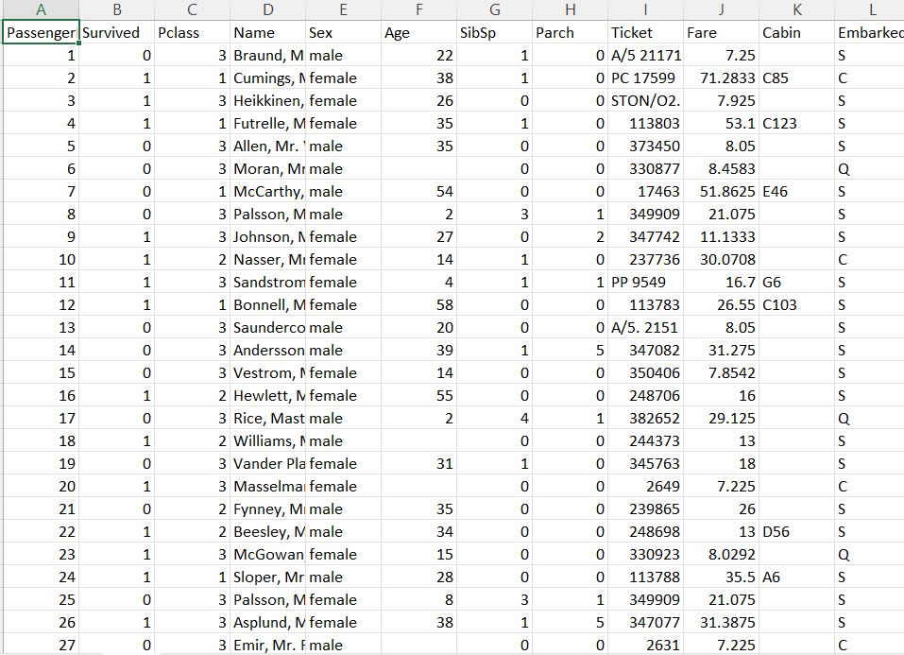

Slide 5
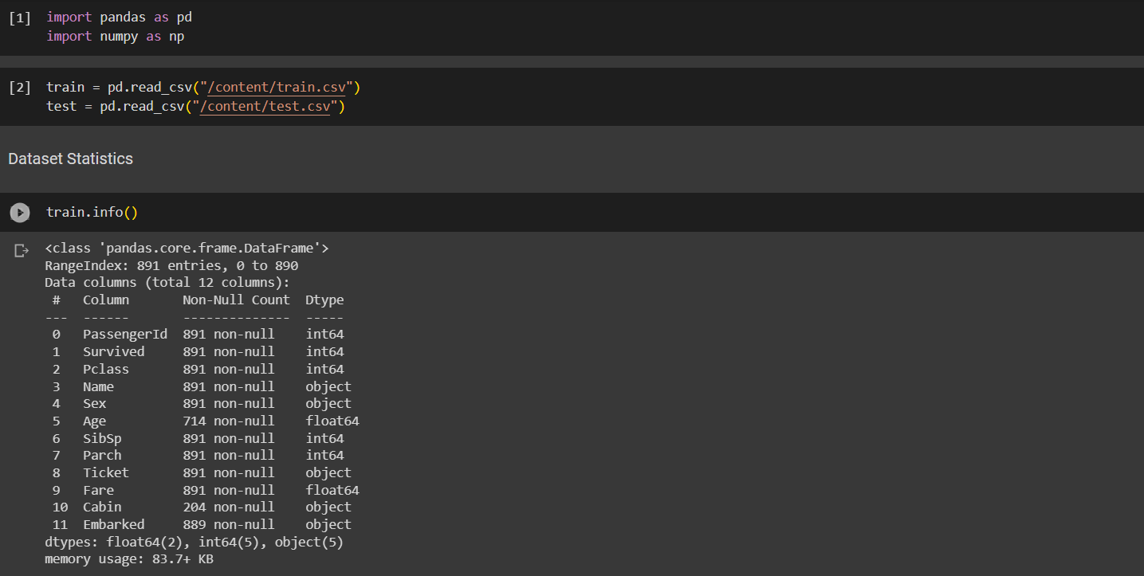
Dataset Statistics:

Slide 6
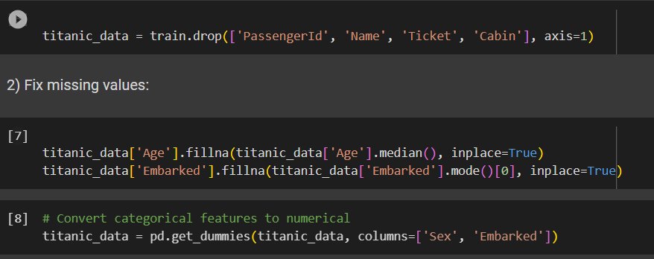
Fix missing values

Slide 7
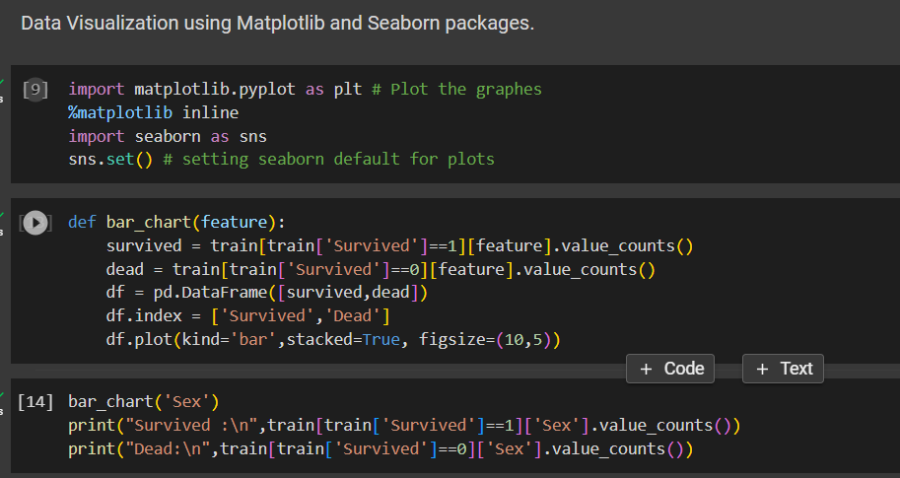
Data Visualization using Matplotlib and Seaborn packages.

Slide 8
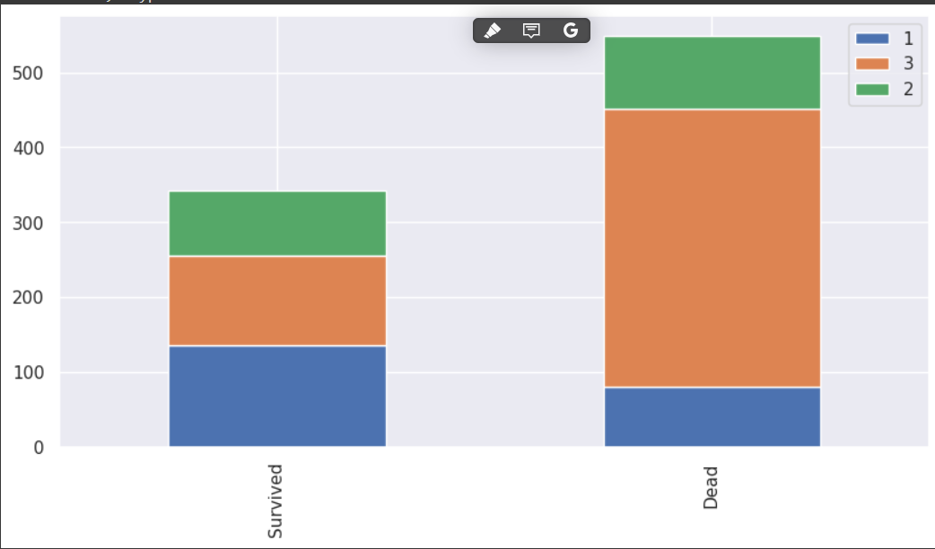
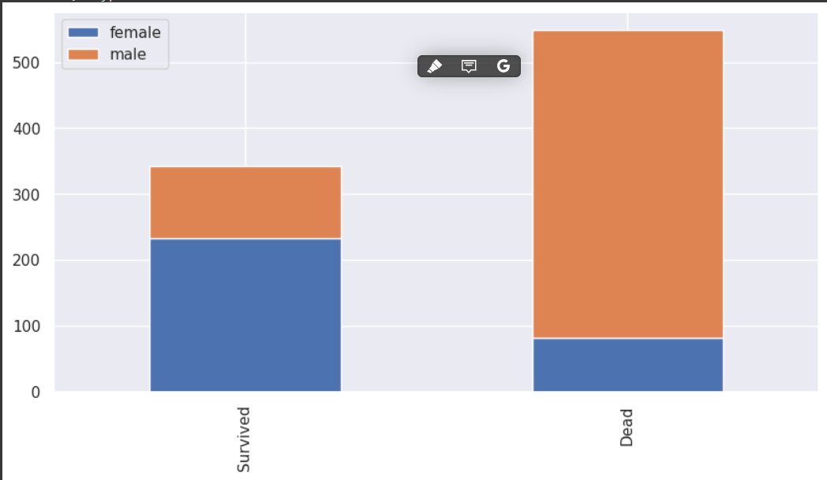
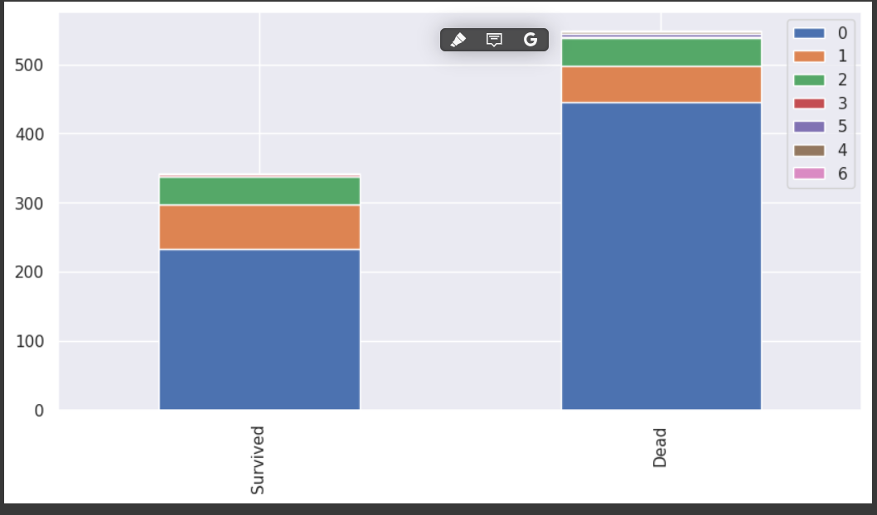
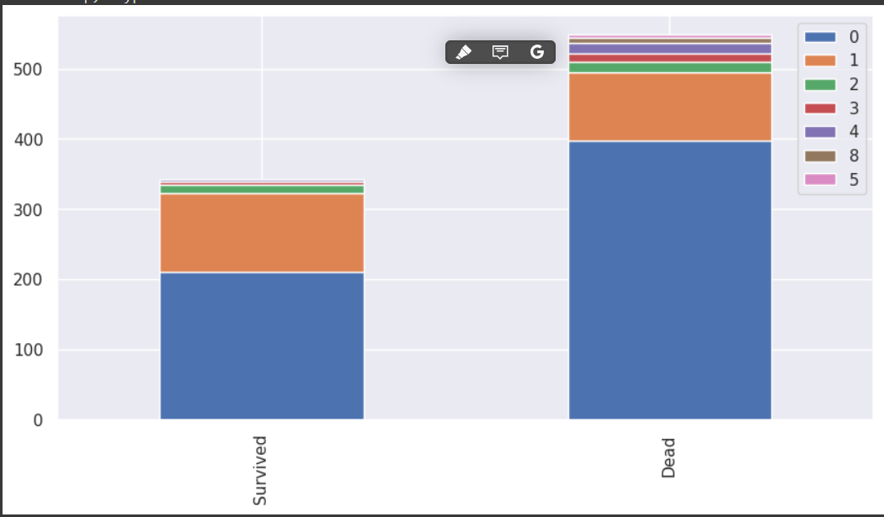

Slide 9
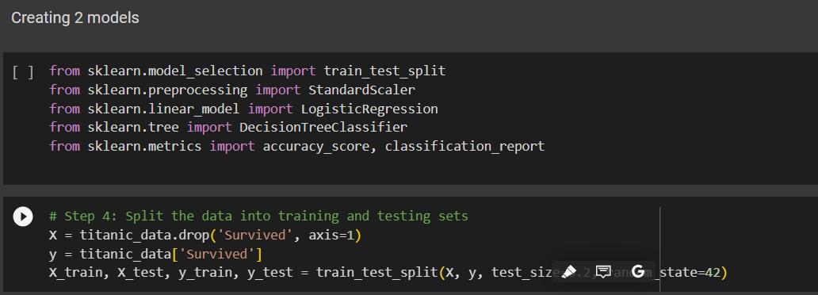
Creating 2 models

Slide 10
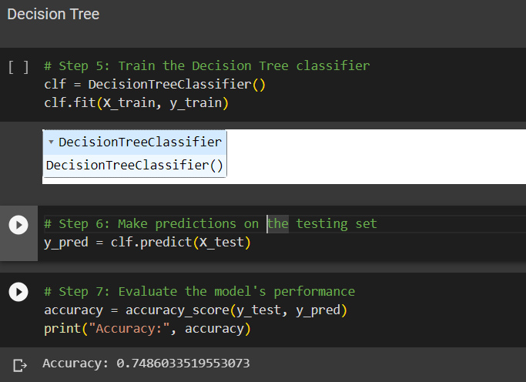
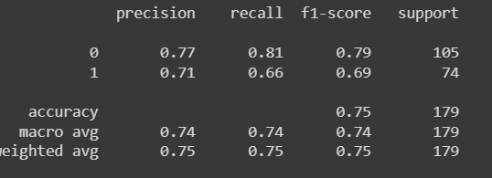
Decision Tree

Slide 11
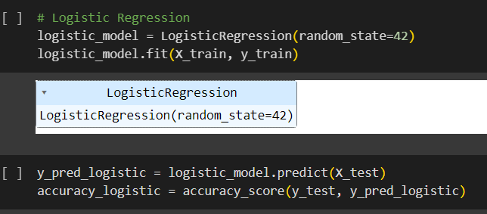
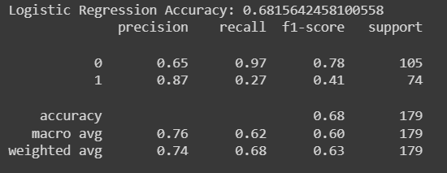
Logistic Regression

Slide 12
Observation
The Logistic Regression model achieved an accuracy of approximately 68%, while the Decision Tree model achieved an accuracy of approximately 76% on the validation set.
In terms of precision, recall, and F1-score, the Decision tree model generally performs slightly better for both survival and non-survival classes.
The Logistic Regression model seems to have a better balance between precision and recall for both classes, as indicated by the F1-scores.

